Slide 1
Incident Response Training
CC NC-BY-SA
Otter Tech LLC
sharp@otter.technology

Slide 2
Introductions:
Name
(Optional) Pronouns you use

Slide 3
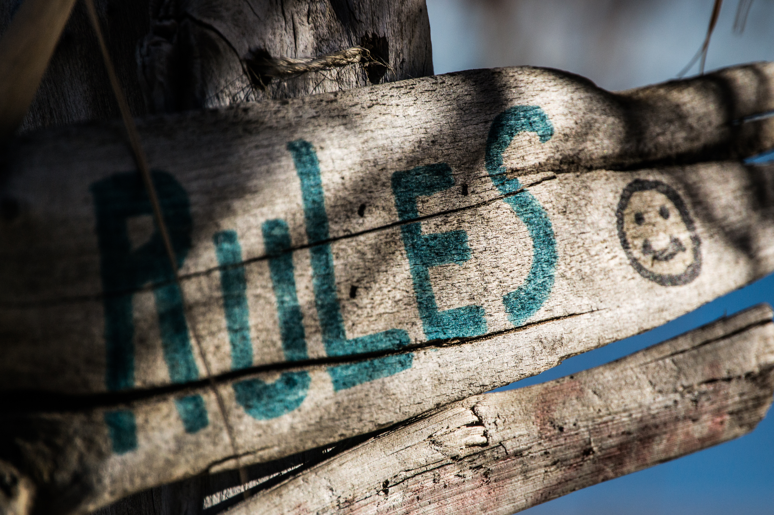
Ground Rules
This is a safe(r) space
If you are asked to stop, you will stop
You may leave at any time
Be open to new knowledge
Acknowledge different lived experiences
CC BY Steve Johnson

Slide 4
Agenda
Who is an incident responder?
Taking an incident report
Practice 1
Responding to a report
Practice 2
Advanced topics, questions, and/or more practice

Slide 5
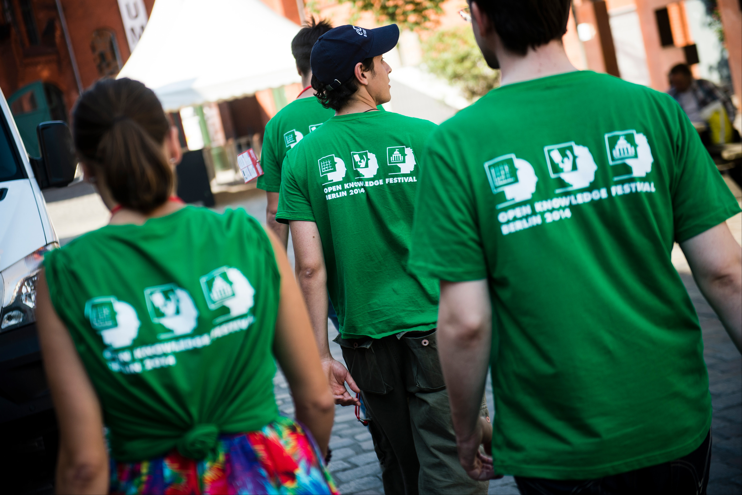
Who is an incident responder?
Takes incident reports
Assesses the situation
Finds additional help
Resolves the incident
Responds to those impacted
Communicates incident to other staff
CC BY Open Knowledge

Slide 6
Common Reporter Needs
+ Be heard
+ To be respected
+ Feel safe
~ To create meaning
- To be "right"
- Justice or vengeance

Slide 7
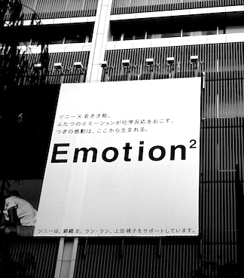
Common Reporter Emotions
Repeating themselves
Becoming flustered
Talking fast
Mistrust
Judgment words
Anger
Emotion CC BY 2.0 Osamu Kaneko

Slide 8
Taking an Incident Report: LASER
Before: Ask if they want to go to a quiet, private place (or encourage them to use private message/email)
Listen and summarize
Acknowledge emotions with "You" statements
Seek assistance or resources as needed
Ensure everyone is safe
Report or Respond to the incident
After: Thank reporter for reporting the incident

Slide 9
Practice
Receiving Reports

Slide 10
Instructor modeling
taking a report
Questions

Slide 11
Bias in Receiving Incident Reports
Record the facts
Don't use "judgment" words
Watch yourself for defensiveness
Be cautious about empathy for reported person

Slide 12

Microaggressions & Trust
Unconscious bias made invisible by privilege
Different lived experiences
Death by 1,000 paper cuts
Brings up strong emotions
Emotional labor of education
CC BY Andrew McGill

Slide 13

Intent is Not Magic
Ignorance is no excuse
Actions have impact
No tone policing victims
No "reverse"-isms
No “I'm sorry if I hurt you”
CC BY Fabricio Zuardi
(modified)

Slide 14
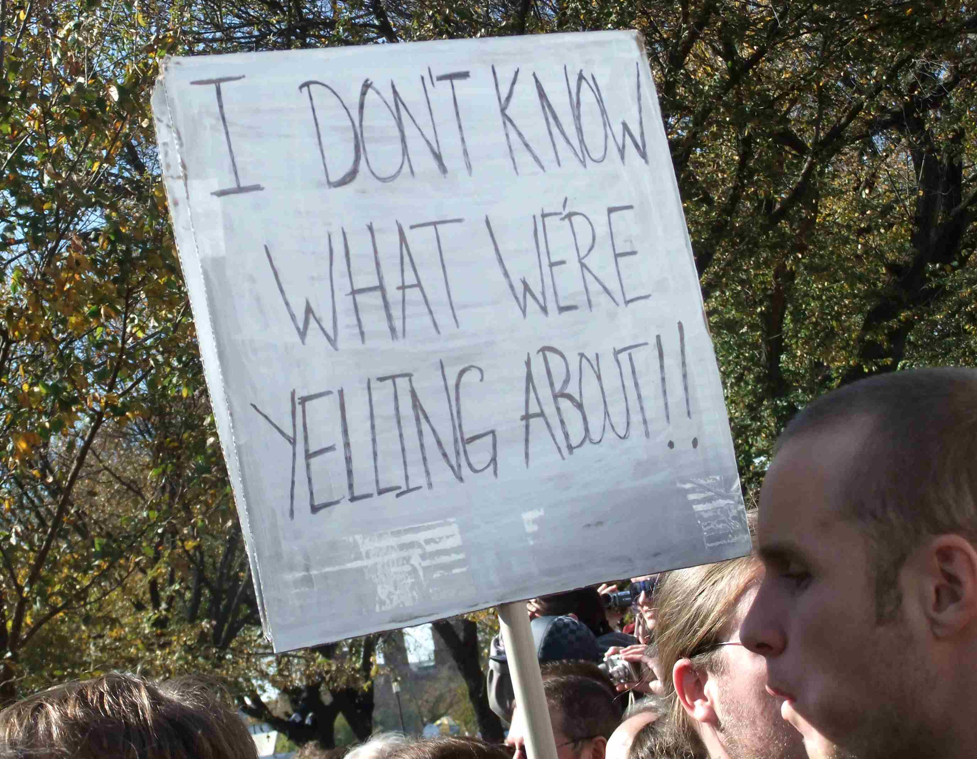
Personal Conflicts
Not all conflicts will be a Code of Conduct violation
Communication breakdown?
Peers raising old grievances?
Is this a pattern?
Know emotional and verbal abuse behaviors: http://outofthefog.website/traits/
CC BY Martha Soukup

Slide 15
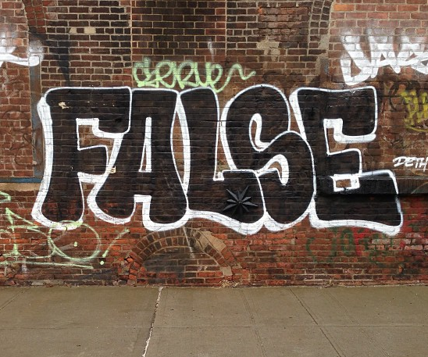
False Reporting: Power Dynamics
What does a reporter have to lose?
Reputation
Career
Financial support
Safety
Mental health
What does the reported person have to lose?
CC BY Adam Lehman

Slide 16
Review All Reports Carefully
Microaggressions & sexual harassment are under reported
Examine the power dynamics
Be cautious of "reverse"-ism reports
CC BY Adam Lehman

Slide 17
(Break?)
Following up on
Incident Reports

Slide 18
Evaluating Risk
 | Low Risk | High Risk
Low Impact | Microaggression in conversation Microaggression in private message | Repeated borderline incidents History of subtle verbal abuse
High Impact | Racist or sexist joke during presentation Inappropriate joke on a public channel | Ongoing harassment or stalking Online harassment campaign or doxxing

Slide 19
Deciding Response
 | Low Risk | High Risk
Low Impact | Issue warning | Monitor and document patterns of behavior, warn or temporary ban, remove from leadership
High Impact | Reprimand, removal of offensive material Public response from staff or organization | Coordinated planning Additional resources Reach out to others

Slide 20
Common Emotions for People who have been reported
Emotion | Action
Disgust | Self blame
Anxiety | Seek reassurance
Fear | Denial
Anger | Defensiveness
Humiliation | Blame shifting
Abandonment | Manipulation

Slide 21
Following up with the reported person: JARRING
State what happened with no Judgment words
Affirm the impact on the reporter
Allow the reported person to Respond
Your job is not to Reassure
Focus on the Impact of their behavior
Call them iN, "I need your help making this a welcoming/safe/inclusive event/community"
Give them a plan to modify their behavior
Don't let them contact reporter, but offer to relay the apology
Notes:
“Hi, can I speak with you privately?”
“That's not appropriate.”
“They asked you to stop.”
“This is a private venue.”

Slide 22
Practice:
Following up with
the Reported Person

Slide 23
Instructor modeling
following up with
a reported person
Questions

Slide 24
Following up with reporters
Follow up is optional
Try to talk to everyone impacted
May need a public statement
Whisper networks exist
Don't justify your actions
Document the incident
May need to notify volunteers

Slide 25
Advanced Topics

Slide 26
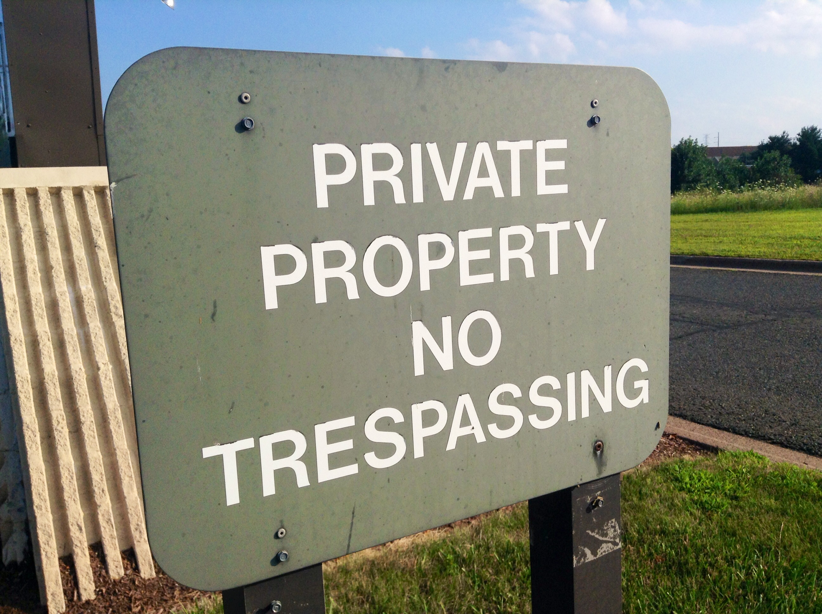
Dealing with Unwelcome Attendees
“You aren’t permitted to attend the conference”
Don’t provide details
Ask them to leave
“This is a private venue”
Get onsite help
Report for trespassing
Know your local trespassing laws
CC BY Mike Mozart

Slide 27
Dealing with Weapons Policy Violations
“Weapons are not allowed at our conference”
Ask them to leave
Come back without the weapon
Do not argue, be firm
Ask staff, response team, security to help
If there is a safety risk, call 911

Slide 28
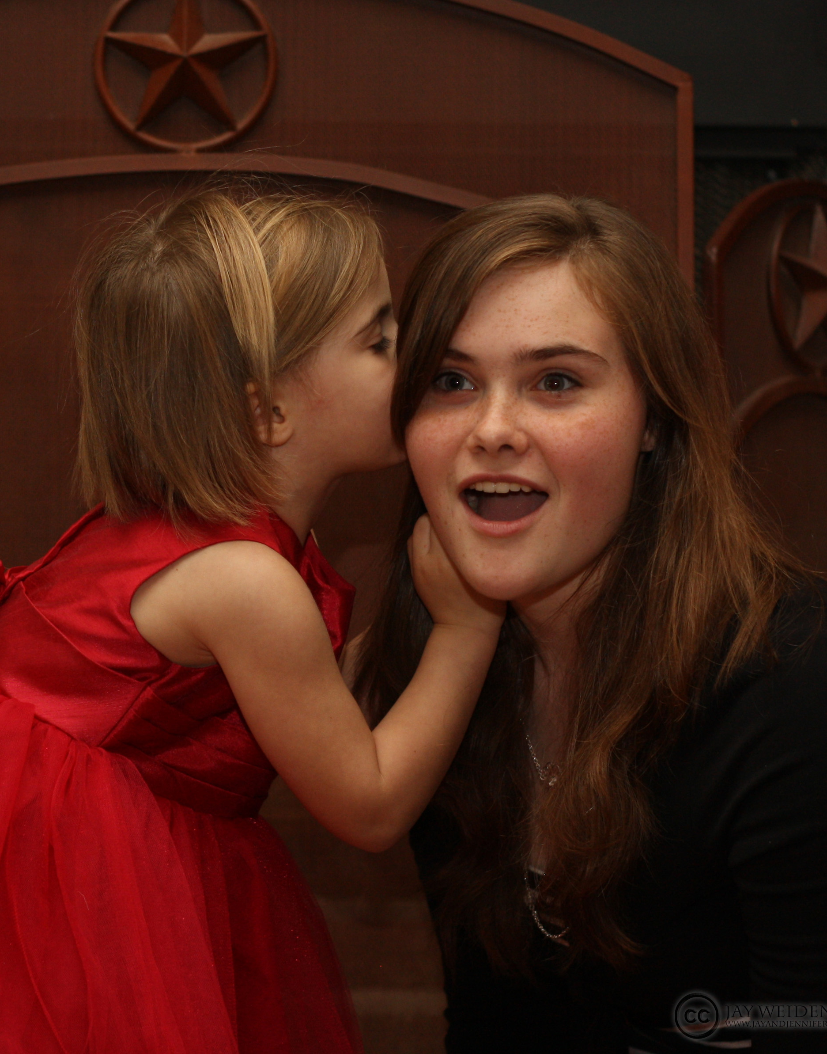
Conflicts of Interest
Is anyone a friend or coworker?
conference staff or volunteers
incident response team
papers committee
sponsors
Review leadership positions for potential leaks:
other incident responders
volunteers & staff
papers committee
board members
CC BY Jay Weldenbach

Slide 29
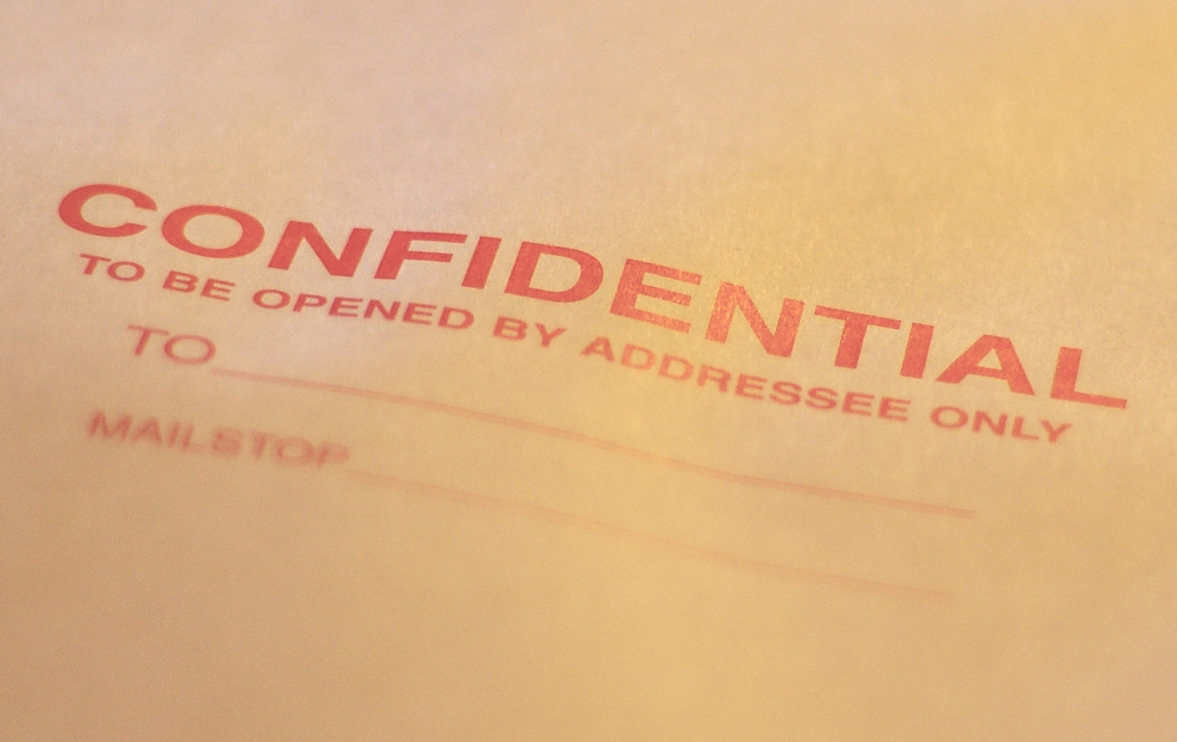
Confidentiality Issues
Reporter fears retaliation
NDAs & severance
Police Investigation
Limit incident docs access
Ask around (discretely)
Often multiple incidents
Other grounds to dismiss
CC BY Casey Marshall

Slide 30
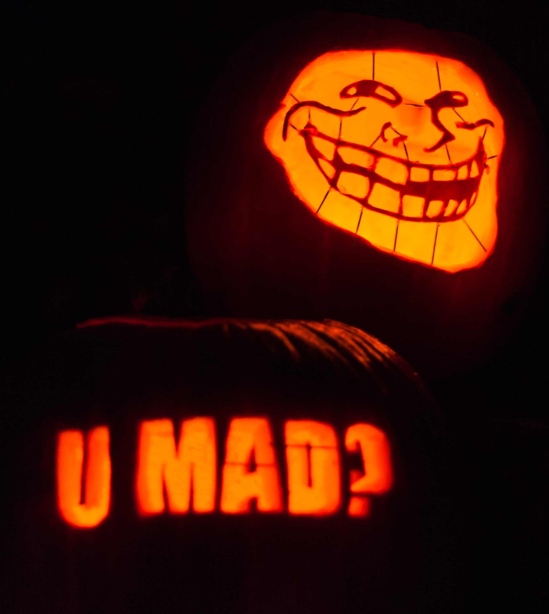
Known Harassers
Not just internet trolls
Stalkers do show up
Power plays & disruption
Have a mitigation plan
Strict confidentiality plan
Ensure attendee safety
CC BY Paul VanDerWerf

